Slide 1
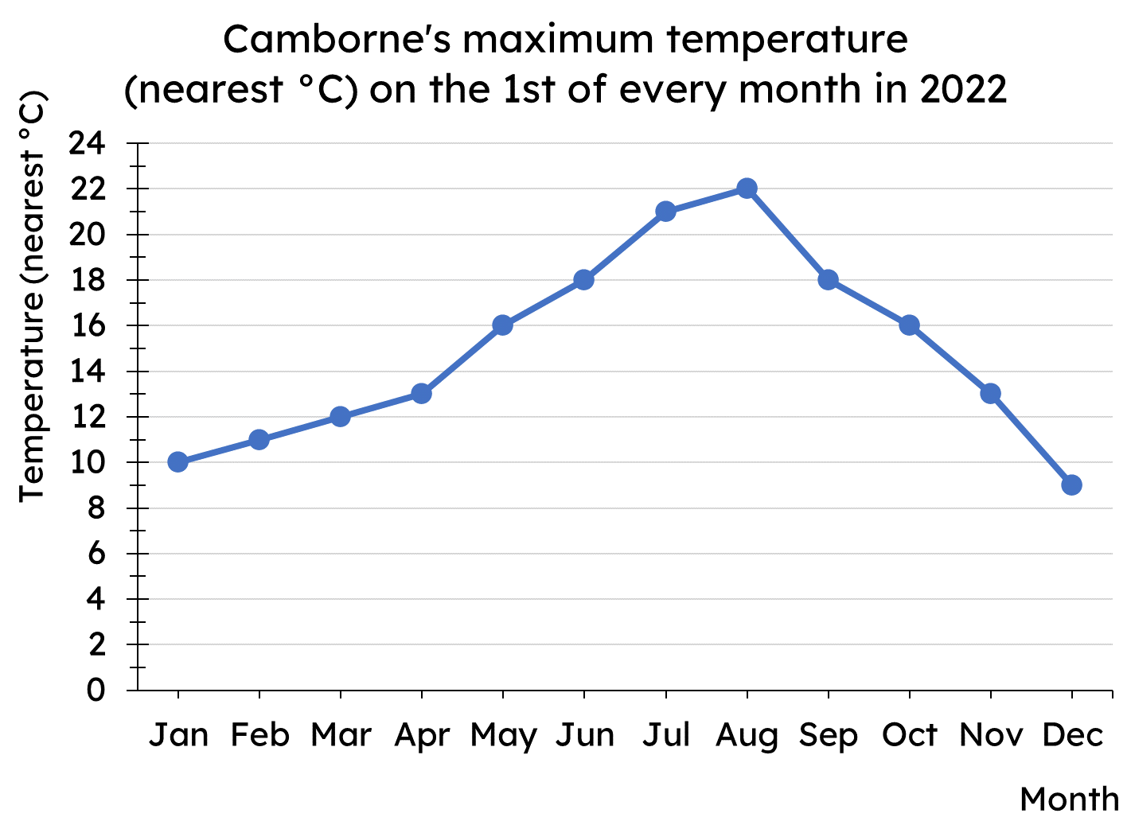
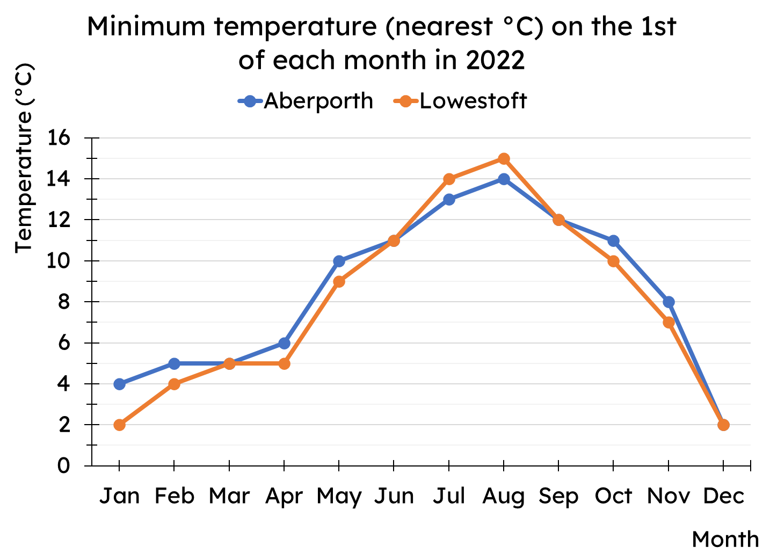
Calculating the mean
Task A: Calculating the mean from a line graph
Use the line graph to complete the table of data.
Jan
Feb
Mar
Apr
May
Jun
Jul
Aug
Sep
Oct
Nov
Dec
Calculate the mean of each data set shown on the line graph.

Slide 2
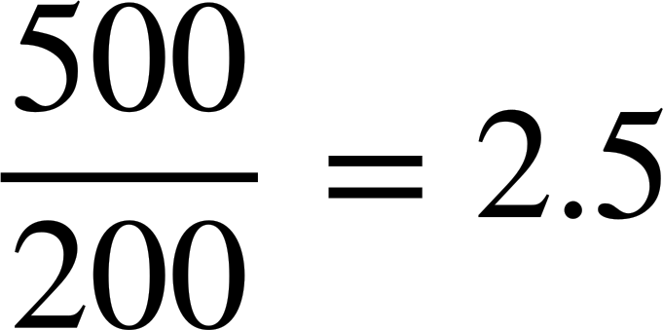
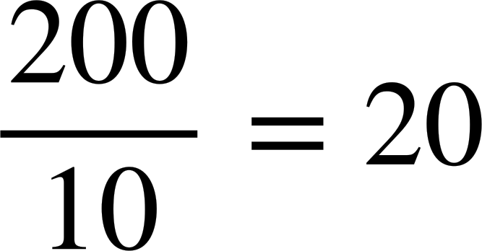
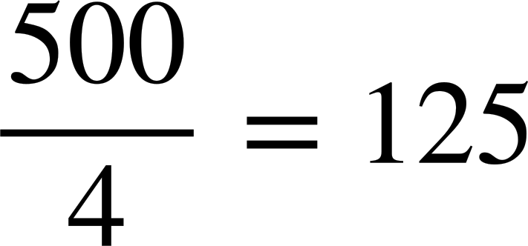
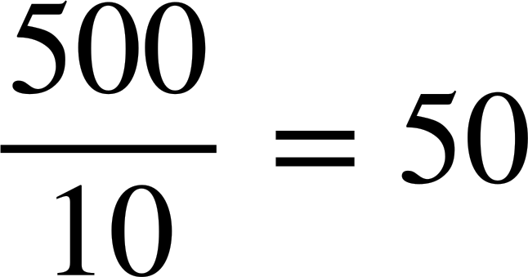
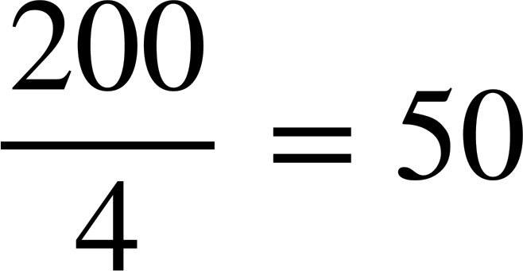
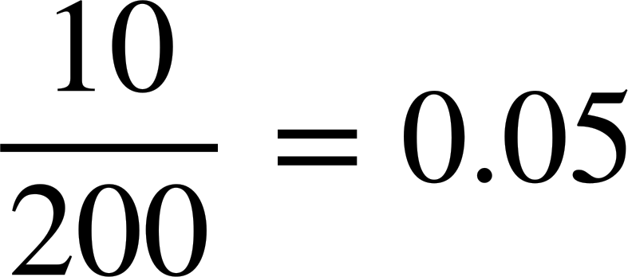
Calculating the mean
Task B: Calculating the mean from an ungrouped frequency table
1) A class take a quiz, marked out of 6. The frequency table shows the results for the class.
Quiz score | 0 | 1 | 2 | 3 | 4 | 5 | 6
Frequency | 3 | 4 | 4 | 7 | 10 | 4 | 1
a) How many pupils are in the class?
b) How many marks did the class get as a group?
c) Hence, what is the mean marks per pupil?
The frequency table shows the number of bedrooms in different houses within an area of a town.
Which calculation correctly finds the mean for this frequency table? For each incorrect answer, why is it wrong?
Bedrooms | Frequency
1 | 20
2 | 93
3 | 54
4 | 33
a)
b)
c)
d)
e)
f)

Slide 3
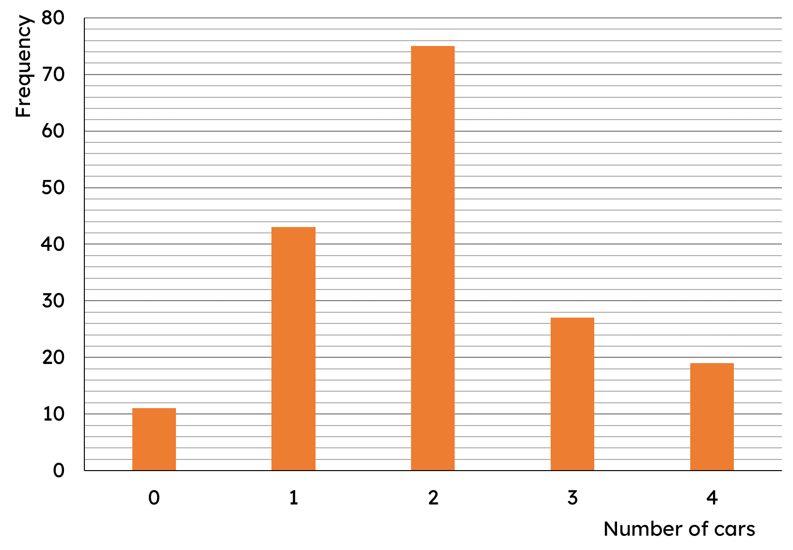
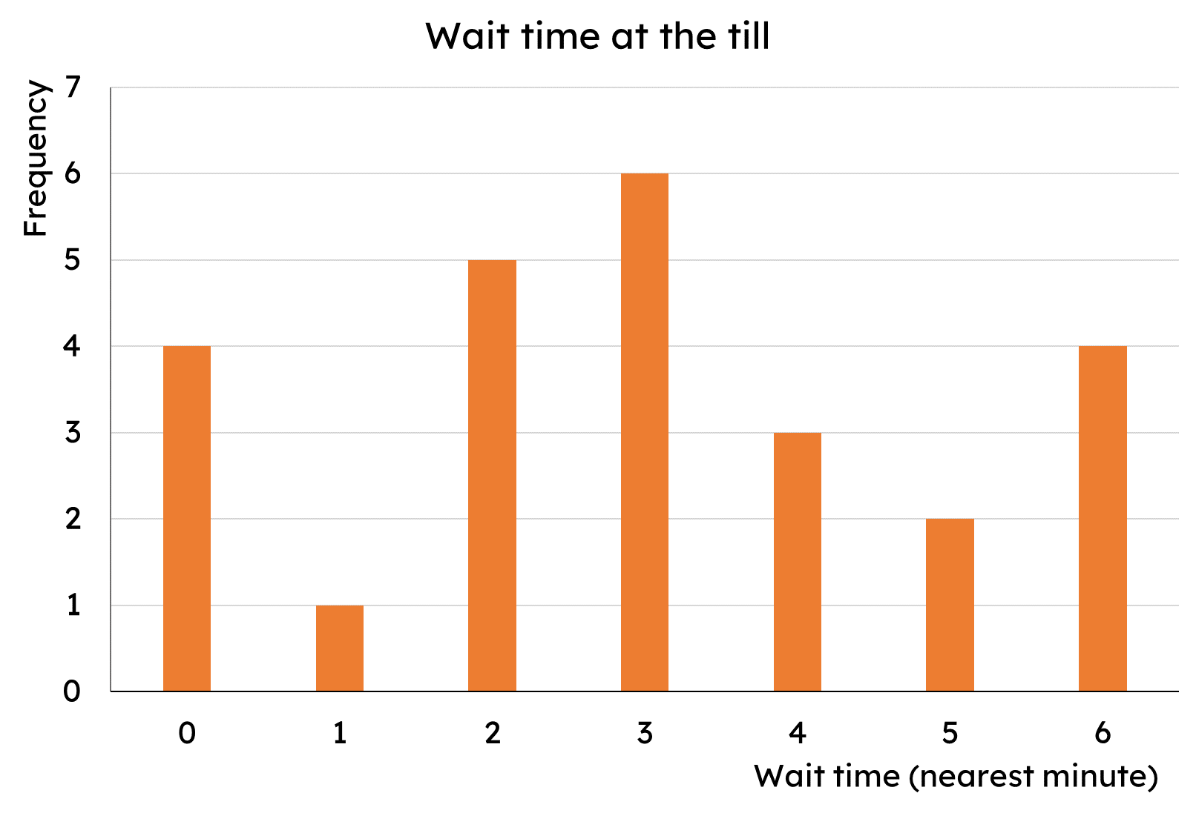
Calculating the mean
Task C: Calculating the mean from a bar chart
This bar chart shows the number of cars per household.
a) How many households are there?
b) How many cars are there in total across all households?
c) What is the mean number of cars per household?
2) The bar chart shows the length of time customers spent waiting at a self-service till (to the nearest minute).
What is the mean wait time?
Mathematics in Education and Industry
v2.1

